Slide 1
FULL STACK DEVELOPMENT
Using the Buffer Module
to Buffer Data
SANJANA PATIL
22H51A05J1
CSE D
Sanjana Patil
22H51A05J1
CSE - D

Slide 2
INTRODUCTION
The Buffer Module is a fundamental building block in Node.js. It provides a way to work with raw binary data, which is essential for handling network protocols, file systems, and other low-level operations.

Slide 3
What is the Buffer Module?
The Buffer Module in Node.js enables the handling of binary data by representing it as fixed-length arrays of bytes. This allows developers to manipulate, process, and exchange data in its raw format, which is crucial for various applications.

Slide 4
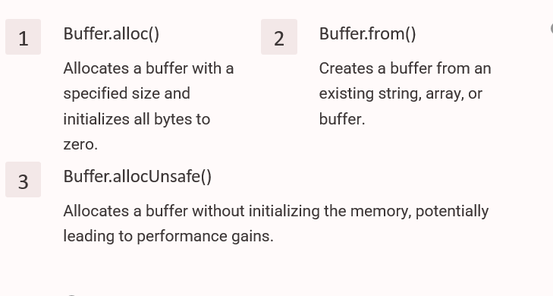
CREATING BUFFERS
We can create buffers using the following methods:

Slide 5
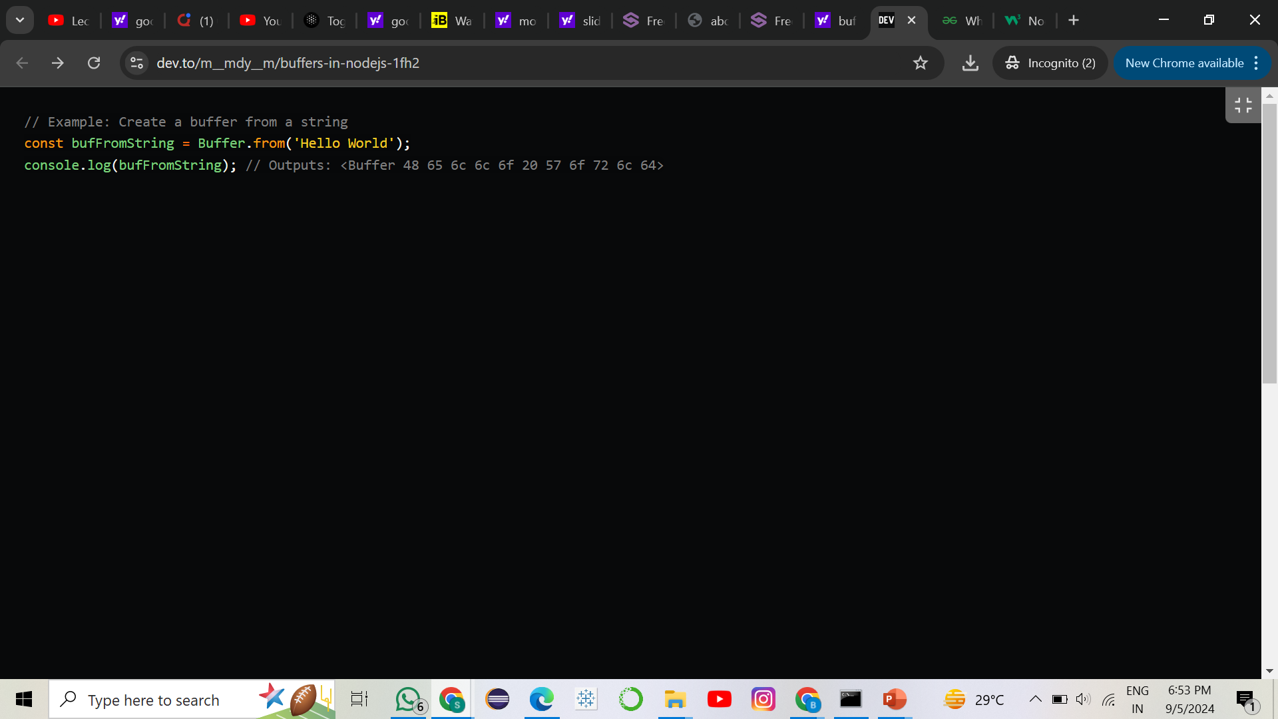
EXAMPLE

Slide 6
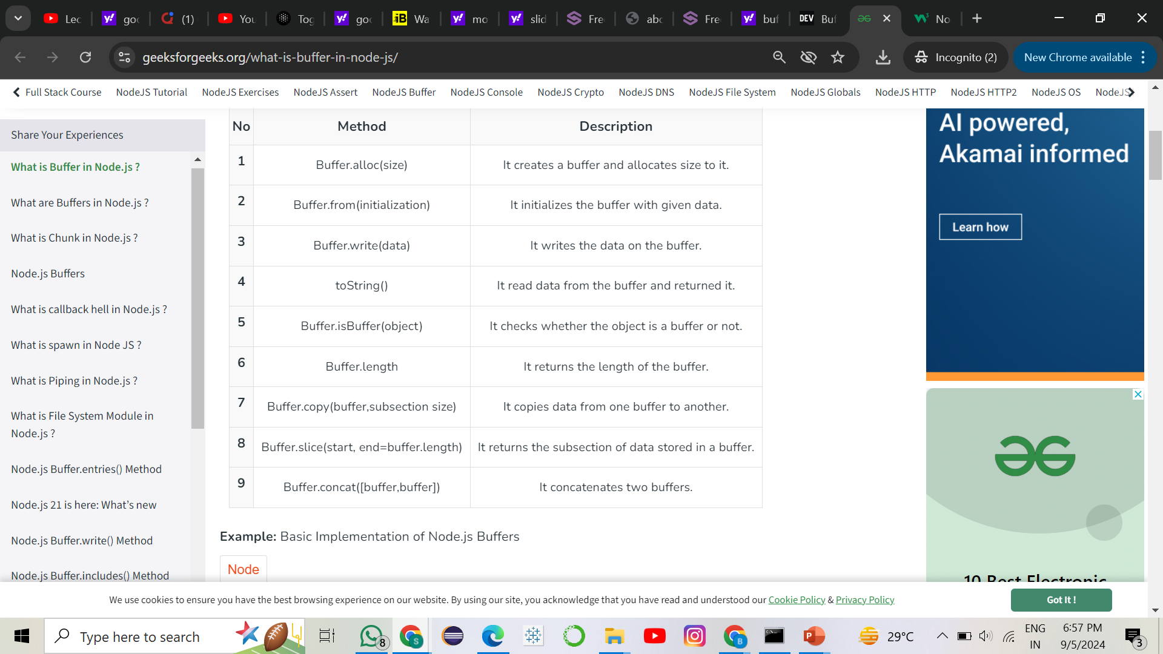
BUFFER METHODS

Slide 7

COMPARING BUFFERS

Slide 8
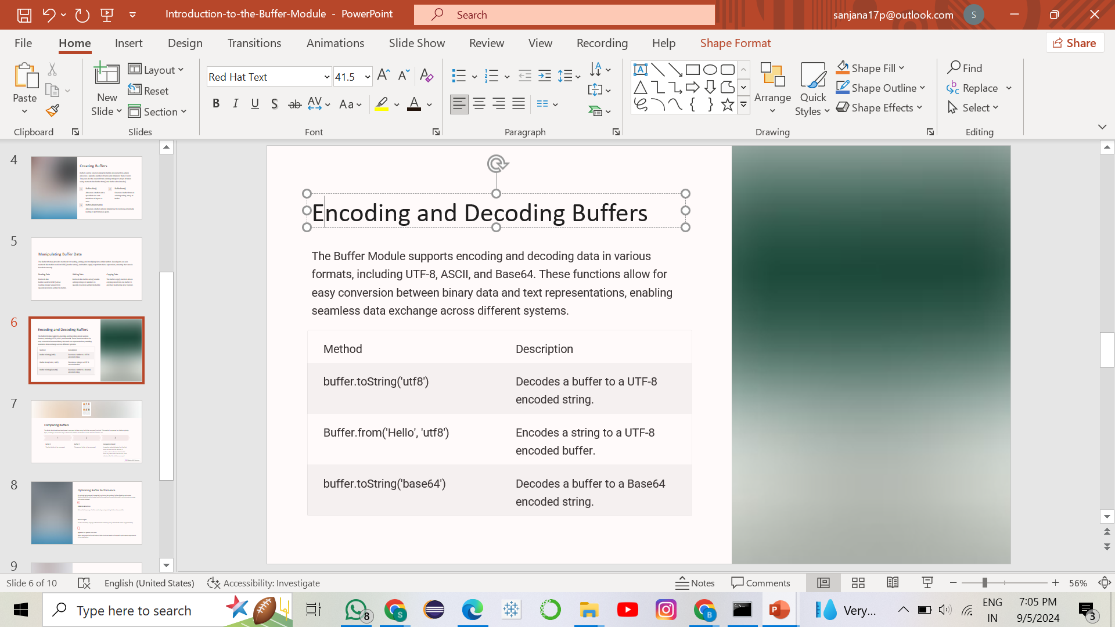
ENCODING AND DECODING BUFFERS

Slide 9
BEST PRACTICES FOR USING BUFFERS
Buffer Allocation: : Always initialize buffers with a known size using Buffer.alloc()
Avoid Buffer Overflow: : It’s crucial to manage buffer sizes and boundaries properly. Buffer overflows can lead to security vulnerabilities
Use Existing Buffers When Possible: : If you’re dealing with a stream of data, rather than creating a new buffer for every new piece of data, reuse an existing buffer and fill it with new data as it comes in, thus reducing garbage collection overhead.
Conversion to Strings: : When converting buffer contents to a string, be sure to specify the correct encoding (e.g., ‘utf8’, ‘base64’).

Slide 10
THANK YOU

